Slide 1
Movie Searching
BasedCoders​

Slide 2
AGENDA
IT’S A MOVIE SEARCHING WEBSITE WHICH SHOWS YOU ALL THE MOVIES ACCORDING TO YOUR SEARCH CRITERIA.
HUSTLE FREE MOVIE SEARCHING
​
IT CAN FURTHER BE DEVELOPED TO GIVE PLATFORM SPECIFIC MOVIES.
​THIS PROJECT IS CREATED FOR DIVERSION 2K23
THIS IS ALL YOU NEED FOR HUSTLE FREE SUNDAY MOVIE SEARCH.

Slide 3
Introduction
From TV Guide Online - a searchable database (see Movie Reviews) that includes the cast, credits and reviews for some 40,000 movies released in the U.S,INDIA.
Filter genres, subgenres, moods, themes, star rating, release date to dig through movies in our database to find what you are looking for. Search boxes within categories help narrow down the characteristic you are looking for. For example, typing "comedy" into the Genres & Subgenres will bring up Standup Comedy, Romantic Comedy, Screwball Comedy, etc.

Slide 4
PRIMARY GOALS
TO MAKE THE MOVIE SEARCHING EASIER

Slide 5
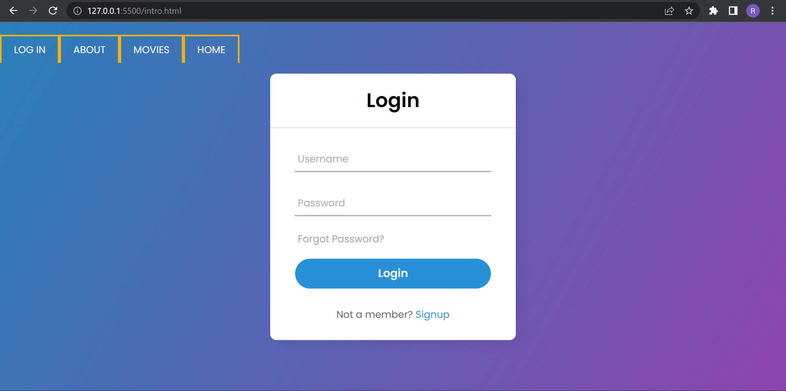
Login page

Slide 6
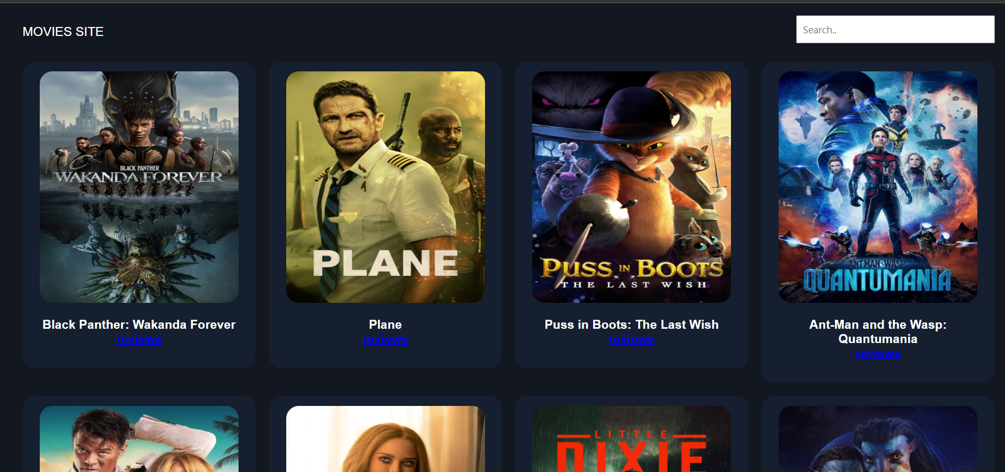
Movie search page

Slide 7

Movie search page

Slide 8
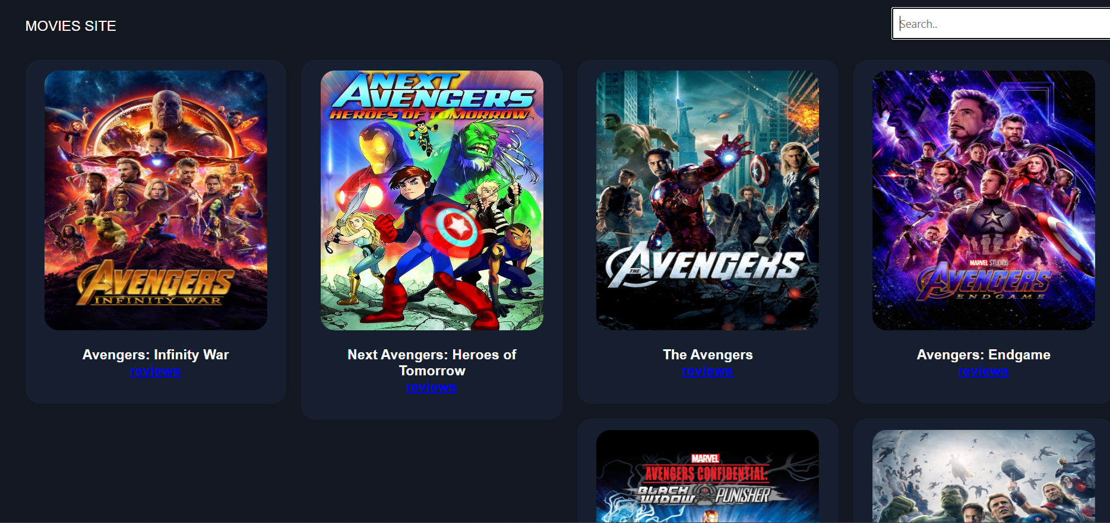
Movie search page

Slide 9
AREAS OF FOCUS
This website focus on convenient movie searches with simple keywords.

Slide 10
THANK YOU
BasedCoders
Sagnik Raha (Admin)
Sourish Sarkar
Ritam Bhattacharya
Samanyu Deghuria

